Slide 1
Future Fund
Genomics Health Futures Mission
National Consultation on the Roadmap, Implementation Plan and Summary of Recommendations from the Scientific Strategy Committee Report
Webinar

Slide 2
Contents
Introduction
Medical Research Future Fund (MRFF)
Background
MRFF10-Year Investment plan
MRFF Missions
Purpose of Consultation
Genomics in Australia
Genomics Health Futures Mission
Expert Advisory Committee
Scientific Strategy Committee Report
Roadmap
Implementation Plan
Investments
Genomics Health Futures Mission – Roadmap, Implementation Plan and Summary of Recommendations from the Scientific Strategy Committee Report Consultation
Open Discussion – Questions & Answers
Consultation Questions

Slide 3
Introduction
Welcome
No microphones will be active, only hosts are able to speak
All questions can be sent via the interactive Q&A input
One hour has been allocated at the end of the presentation to answer questions
A copy of this presentation will be made available on the MRFF website

Slide 4
MRFF Background
Established in 2015, the $20 billion Fund is a long-term sustainable source of research funding
The MRFF aims to transform health and medical research and innovation to improve lives, build the economy and contribute to health system sustainability
Complementary Government funding of health and medical research in Australia:
MRFF - awards funding for national priority areas that address gaps in research with a focus on research translation and commercialisation to improve the health and wellbeing of Australians
NHMRC - awards funding through a range of investigator-initiated schemes to build capacity and advance health and medical knowledge

Slide 5
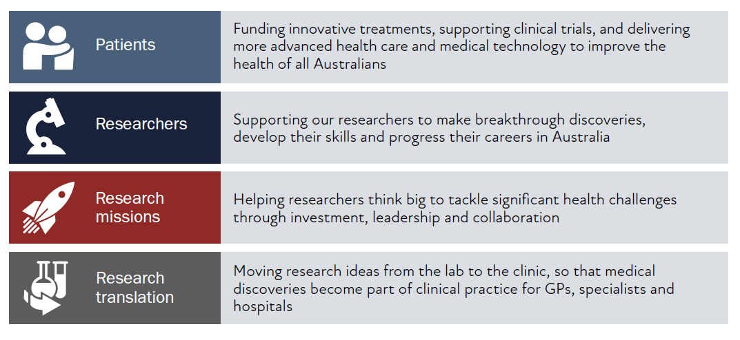
MRFF 10-year investment plan
The Australian Government announced a $5 billion, 10-year investment plan for the MRFF, as part of the 2019-20 budget.
There are 20 initiatives under four themes, funded over 10 years to harness innovation, provide vital infrastructure, improve patient outcomes, and generate jobs and economic growth.

Slide 6
MRFF Missions
MRFF missions:
focus on an area of unmet need or a technology with transformational potential (priority led)
are planned and coordinated 10 year programs of work (strategic, Roadmap, Implementation Plan)
bring together key researchers, health professionals, consumers, stakeholders, industry partners (outcome focused)
harness resources across the system (investment, leadership and collaboration)
use innovative research approaches (new grant models)

Slide 7
Purpose of consultation
Focus: Mission design (Roadmap and Implementation Plan)
Questions:
As designed, will the Mission generate the knowledge required to improve health practice/policy and patient outcomes
Will the proposed grant opportunities elicit the research required to generate the knowledge needed to improve practice/policy and outcomes
In 10 years time, will we know if the Mission has succeeded (evaluation measures)

Slide 8
Genomics in Australia
Shared responsibility for genomics policy and funding in Australia
National and state-based genomics health alliances established
Australian Genomics Health Alliance is a collaborative research partnership of more than 80 organisations piloting a whole-of-system approach to integrating genomics into healthcare
Key policy frameworks comprise:
National Health Genomics Policy Framework 2018-21
agreed by all Australian Health Ministers in 2017
five strategic priorities: a person centred approach; workforce; financing; services and data
National Microbial Genomics Framework 2019-2022
developed to provide a consistent, national and strategic view for integrating microbial genomics into the Australian health system, and for identifying microbial genomics policy issues and challenges that need to be addressed

Slide 9
Genomics Health Futures Mission
Forms part of the MRFF 10-Year Investment Plan announced in 2018
The Mission will support world-leading genomics research to help save or transform lives of more than 200,000 Australians through better testing, diagnosis and treatment
$500 million over 10 years from 2018–19 to 2027-28 as outlined below
2018–19 $m | 2019–20 $m | 2020–21 $m | 2021–22 $m | 2022–23 $m | 2023–24 $m | 2024–25 $m | 2025–26 $m | 2026–27 $m | 2027-28 $m | Total $m
8.8 | 56.6 | 68.7 | 69.9 | 54.9 | 50.0 | 50.0 | 50.0 | 50.0 | 41.2 | 500.0

Slide 10
Expert Advisory Committee (EAC)
13 members, comprising eminent researchers, clinicians and legal, ethical, consumer/community, industry and data experts
Role to advise the Minister on the strategic priorities for research investment through the MRFF Genomics Health Futures Missions by defining:
Evidence and knowledge gaps to be addressed to transform health care and health outcomes for individuals and communities
Key research questions that if addressed will deliver meaningful change to patients through the translation of research

Slide 11
Scientific Strategy Committee (SSC) Report
Established by EAC on a time-limited basis to prepare a genomics research gap-analysis report
Targeted survey of genomics stakeholders in Australia
Final report: Genomics Health Futures Mission Design, Delivery and Research Priorities was considered and endorsed by the EAC December 2019
Report’s recommendations informed the EAC’s drafting of the GHFM Roadmap and Implementation Plan

Slide 12
Roadmap – Goal and Mission
Our goal
To save or transform the lives of more than 200,000 Australians through genomic research to deliver better testing, diagnosis and treatment
Our mission
To improve the lives of Australians by accelerating research that delivers more effective testing, diagnosis and treatment; facilitates the adoption of new interventions; and consolidates Australia’s international leadership in genomics

Slide 13
Roadmap – Scope
The GHFM will fund research to integrate genomics knowledge and technology into clinical practice. It aims to:
ensure Australians live longer and healthier lives through access to genomics knowledge and technology
position Australia as a global leader in genomics research
deliver improved diagnostics and targeted treatments
avoid unnecessary health costs
improve patient experience and outcomes
The GHFM will also advance precision medicine in partnership with Aboriginal and/or Torres Strait Islander people to ensure genomics research that is scientifically sound, culturally safe, and competent to address inequity in research participation and outcomes

Slide 14
Roadmap – Priority areas for investment
Funding will enable:
faster and more effective disease diagnosis, prevention and earlier intervention
new targeted interventions that transform individual and population health
Increased community awareness and engagement, and better understanding of the societal and economic value of genomics in health care

Slide 15
Implementation Plan
Implementation strategy to guide research investment over the life of the Mission
Priority areas for investment allocated across the short, medium and long term time-frames
Some gaps in the long term to be informed by the outcomes of earlier funding rounds, emerging health priorities and national/international landscape and gap analyses

Slide 16
Implementation Plan
Based on the priority areas and their goals, proposed to:
Identify the investment activities required to achieve these goals
Identify additional activities outside of the Mission that will be required to achieve success
Identify opportunities to leverage additional investment
Define what success will look like, how this might be measured and across what timeframe

Slide 17
Genomics Health Futures Mission - early investments
‘Mackenzie’s Mission’ - $20m / 3 years for a pilot research study of reproductive carrier screening involving 10,000 couples for serious X-linked or recessive genetic conditions
‘ProCan’ - $20.4m / 4 years from to use cancer proteomics, genomics, and related multi-‘omic’ big data analysis of tens of thousands of human cancer samples of all cancer types to develop technologies and tools
Australian Genomic Cancer Medicine Program - $50m / 5 years to develop genomic testing that will transform prevention, prediction, diagnosis and treatment
Genomics Projects Grant Round: $33.7m / 3 years for 17 research projects in cancers, paediatric acute care and ethical, legal and social issues related to genomics in health care
Pathogen Genomics Grant Opportunity: $27.02m / 4 years for 4 large scale research projects in pathogen genomics

Slide 18
GHFM – current open grant opportunity
2020 GHFM Grant Opportunity – up to $45 million available in 2020-21 (opened on 16 December 2020, closes 3 March 2021)
Three streams:
(up to $19.5 million) identify and diagnose novel – primarily monogenic or oligogenic – rare diseases and increase the genomic diagnostic rate towards 70% by 2025;
(up to $19.433 million) improve early detection and targeted treatment for the most common cancers to reduce burden of disease;
(up to $6 million) promote diagnostic effectiveness and efficiency through better understanding of the impact of genetic variants through functional genomics.

Slide 19
Genomics Health Futures Mission Roadmap and Implementation Plan Consultation
Roadmap, Implementation Plan and Summary of Recommendations from the Scientific Strategy Committee Report underwent international review in late 2020
Panel comprised experts providing advice in the context of relevant activities occurring internationally, which can inform the strategic direction of the Roadmap and Implementation Plan
Minister for Health is interested in your comments on the Roadmap and Implementation Plan, which will guide future MRFF investments

Slide 20
Consultation – open discussion
One hour allocated
Please type questions in the Q&A box provided on the screen
Questions and feedback will be collated for the presenters to note or discuss
All submissions can be made through the Consultation Hub on the Department of Health website (consultations.health.gov.au)
Reminder - online submissions close 23rd April 2021

Slide 21
Consultation questions
Are the priority areas for investment identified in the Implementation Plan the most effective way for delivering on the GHFM’s goal and aims?
Are there existing research activities which could be utilised to contribute to the Roadmap and/or Implementation Plan aims and priority areas for investment? How can these be leveraged?
Are the ‘Evaluation approach and measures’ appropriate for assessing and monitoring progress towards the GHFM’s goal and aims?
Other?

Slide 22
More information:
health.gov.au/MRFF
consultations.health.gov.au
Interested in accessing MRFF grants:
Register with GRANTCONNECT (grants.gov.au)
Thank you

